Slide 1





Language-based Colorization of Scene Sketches
Changqing Zou*^{1,2}, Haoran Mo*¹, Chengying Gao¹, Ruofei Du³, Hongbo Fu⁴
Sun Yat-sen University¹
Huawei Noah’s Ark Lab²
Google³
City University of Hong Kong⁴
Nov. 20th, 2019
Notes:
Thanks for the introduction. Good morning everyone, my name is Mo Haoran, from Sun Yat-sen University in China. In this talk, I will present our work on language-based colorization of scene sketches.

Slide 2
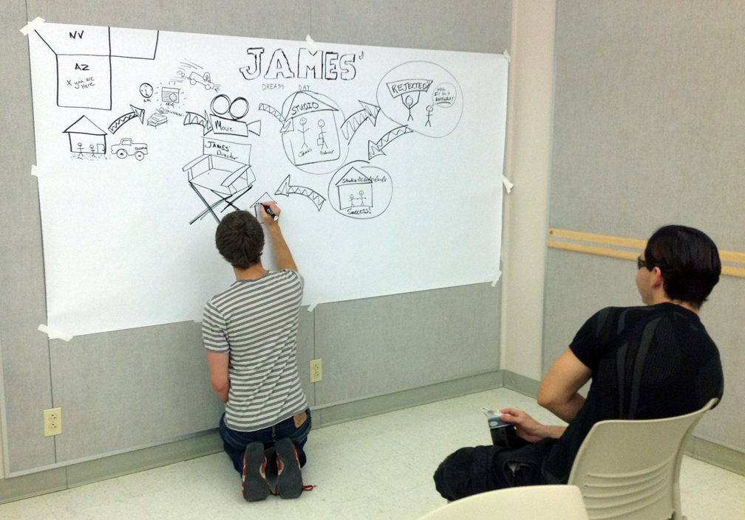
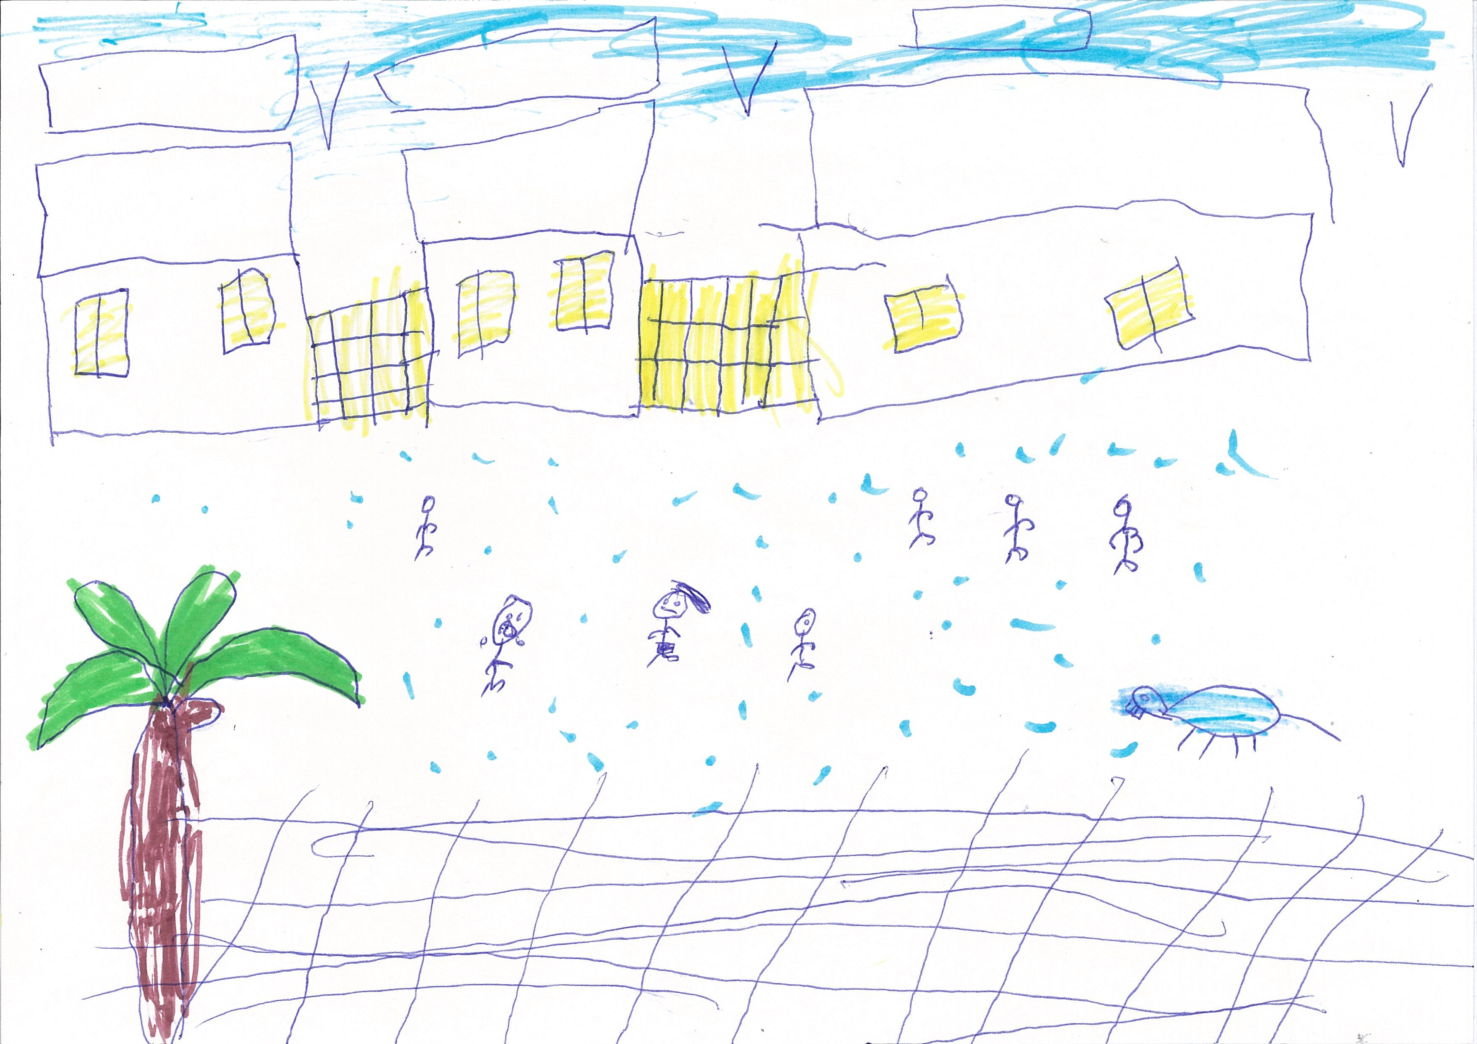
Motivation: Abstract Data and Human Cognition
Sparse
Highly abstract
1
Notes:
Sketch data is sparse and highly abstract. But even a three-year-old child is able to use this kind of data to express their cognition to the world.

Slide 3
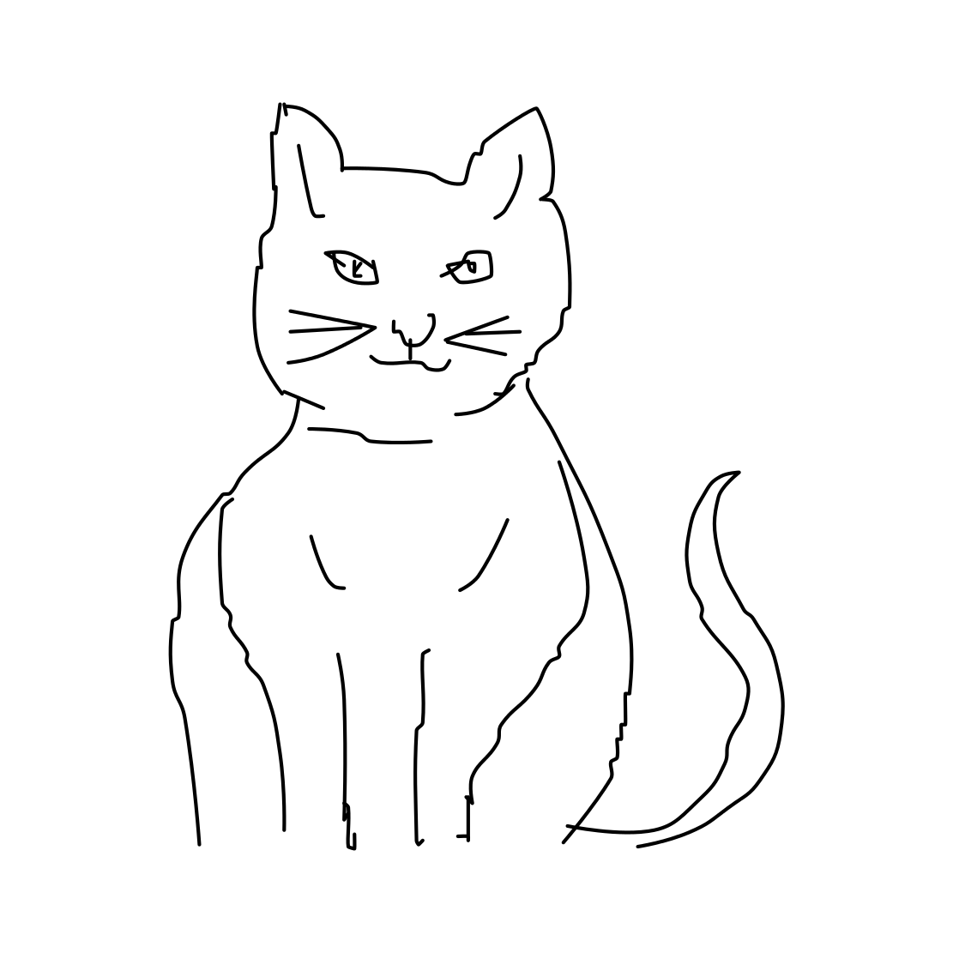
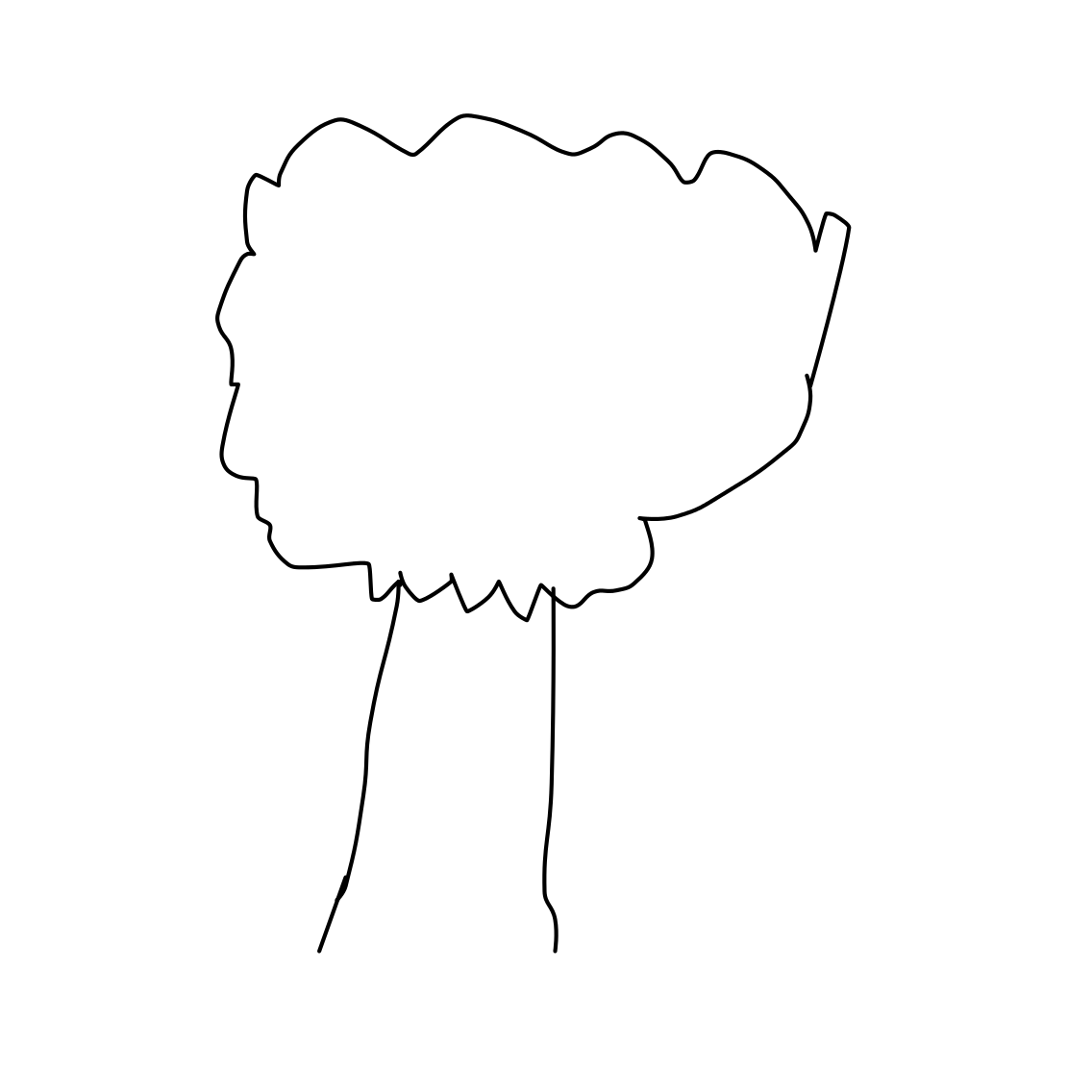
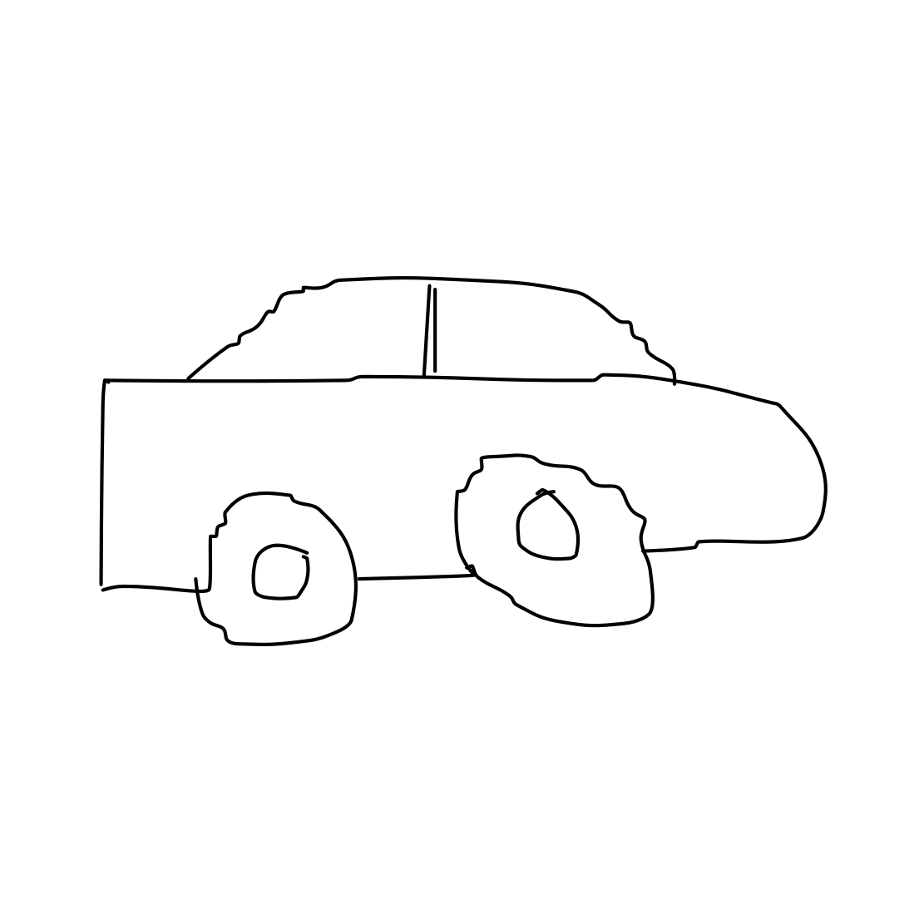
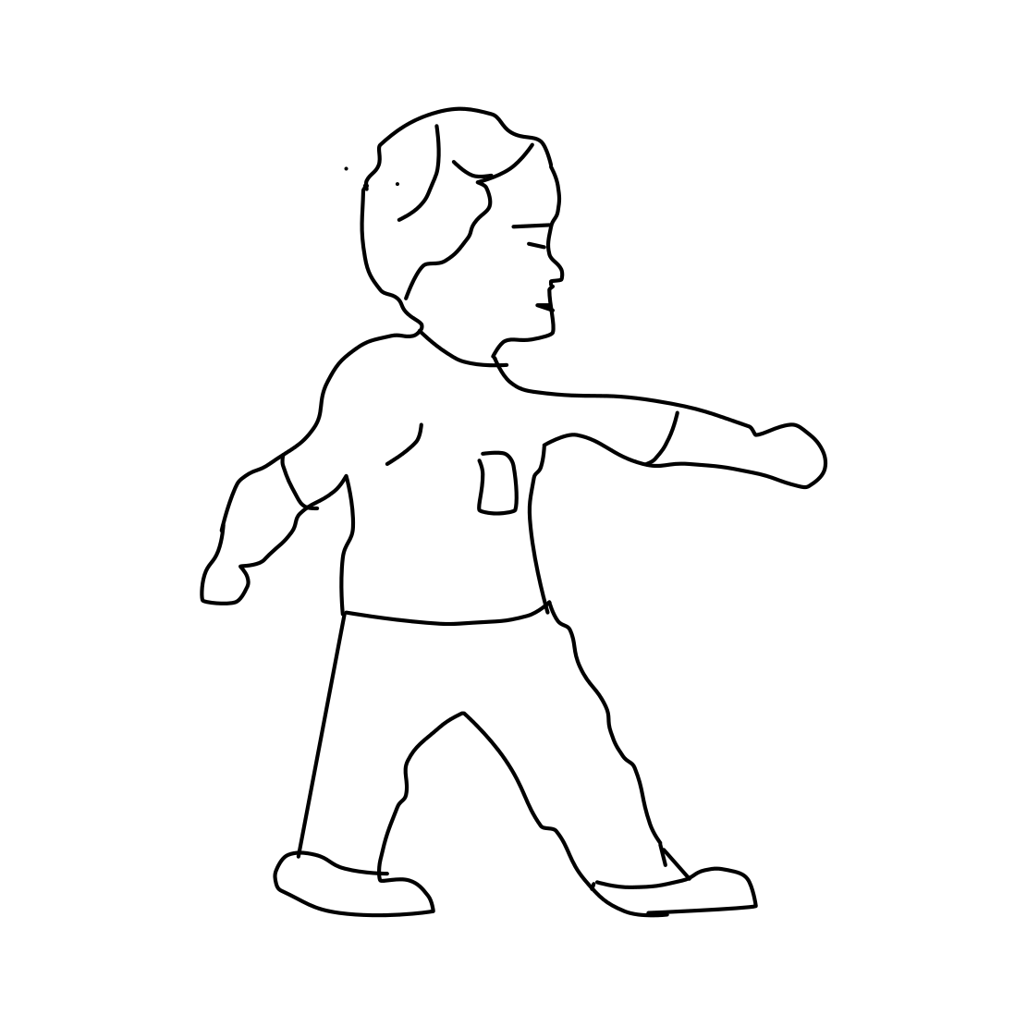
Motivation: Abstract Data Understanding
Lots of early exploration with computational models [Eitz et. al 2012, Li et. al 2013, Schneider et. al 2014, Li et. al 2015]
Limited ability of understanding object-level sketches
[1] M. Eitz, J. Hays, and M. Alexa. How do humans sketch objects? In SIGGRAPH, 2012.
[2] Y. Li, Y. Song, and S. Gong. Sketch recognition by ensemble matching of structured features. In BMVC, 2013.
[3] R. G. Schneider and T. Tuytelaars. Sketch classification and classification-driven analysis using fisher vectors. In SIGGRAPH Asia, 2014.
[4] Y. Li, T. M. Hospedales, Y. Song, and S. Gong. Free-hand sketch recognition by multikernel feature learning. CVIU, 2015.
2
Notes:
A lot of researches have been proposed to explain how human understand this kind of abstract data with computational models.
But even the most advanced models have limited ability of understanding even object-level sketches.

Slide 4
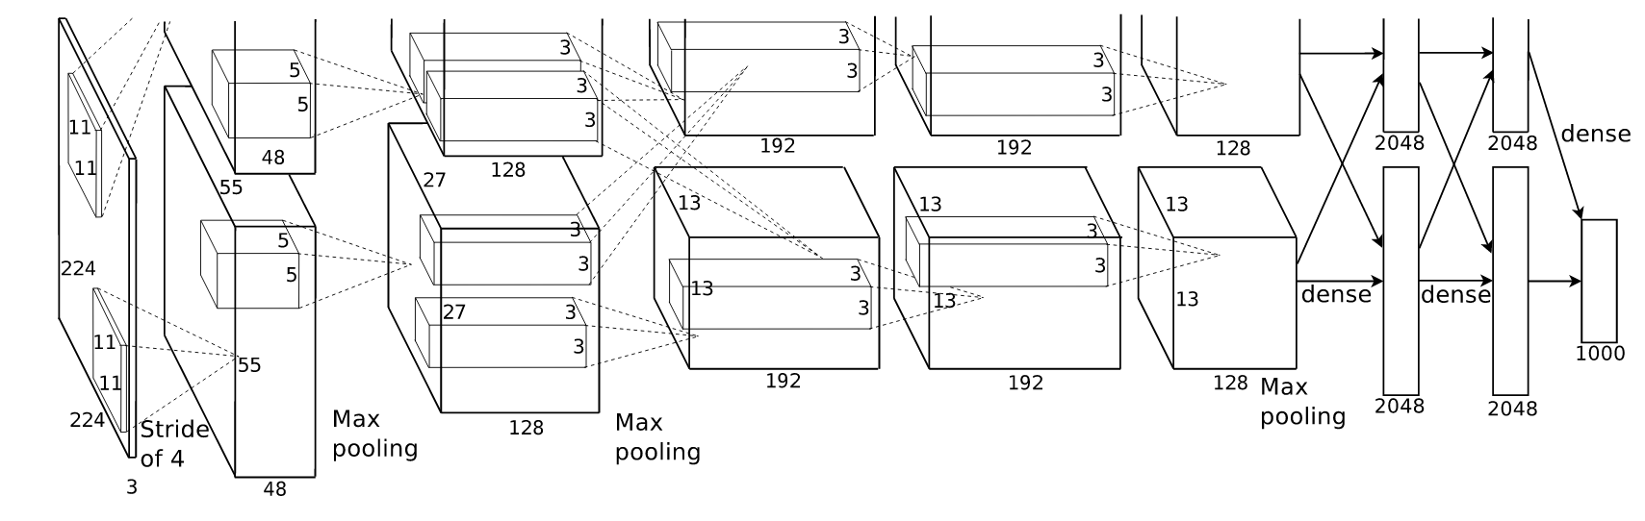
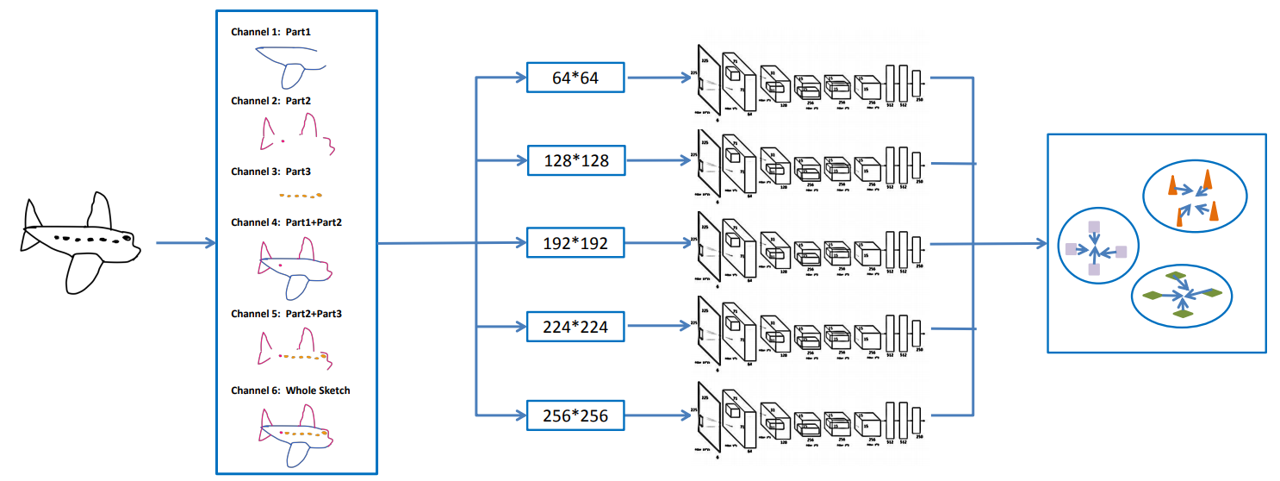
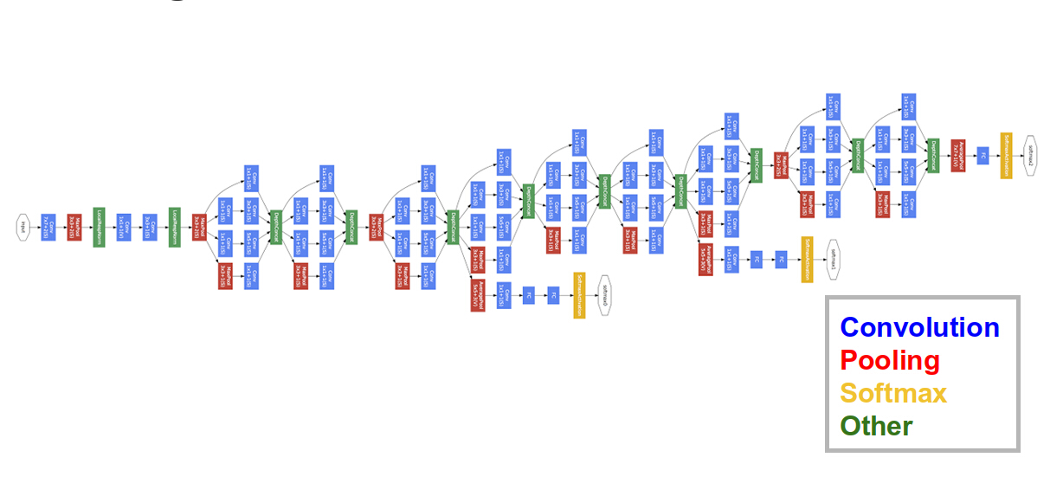
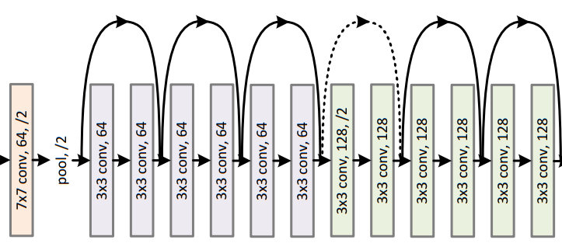
Motivation: Sketch Understanding
TU-Berlin / Sketchy / QuickDraw
3
Notes:
In the past several years, owing to several sketch datasets proposed, such as TU-Berlin, Sketchy and QuickDraw, lots of deep-learning based approaches have came out, for the task of object-level sketch understanding.

Slide 5
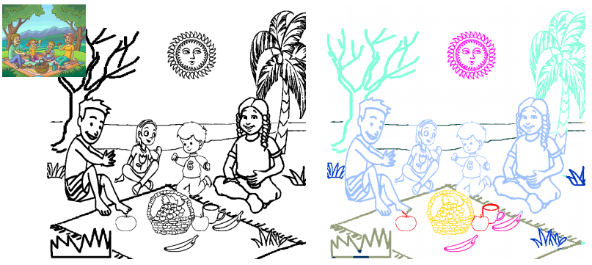
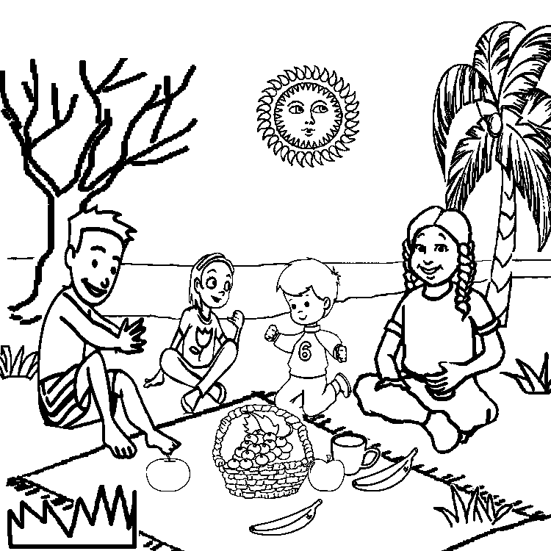
Motivation: Sketch Understanding
vs
SketchyScene [Zou et. al 2018]
Scene-level sketch:
Interaction among multiply objects
More empty region, lack of contextual information
[1] Changqing Zou, et. al. SketchyScene: Richly-Annotated Scene Sketches. In ECCV, 2018.
4
Notes:
But, the understanding of a more complex representation, the scene-level sketch, has been rarely studied.
Compared with object-level sketch, the scene-level sketch data has its unique characteristics:
There are interaction [#click] among multiply objects.
While it has too much empty region, thus making it in poor lack of contextual information, which is what the interaction requires.
So last year, we proposed the first scene-level sketch dataset, sketchyscene. We hope this work can promote the problem of sketch understanding to a new stage, scene level understanding.

Slide 6
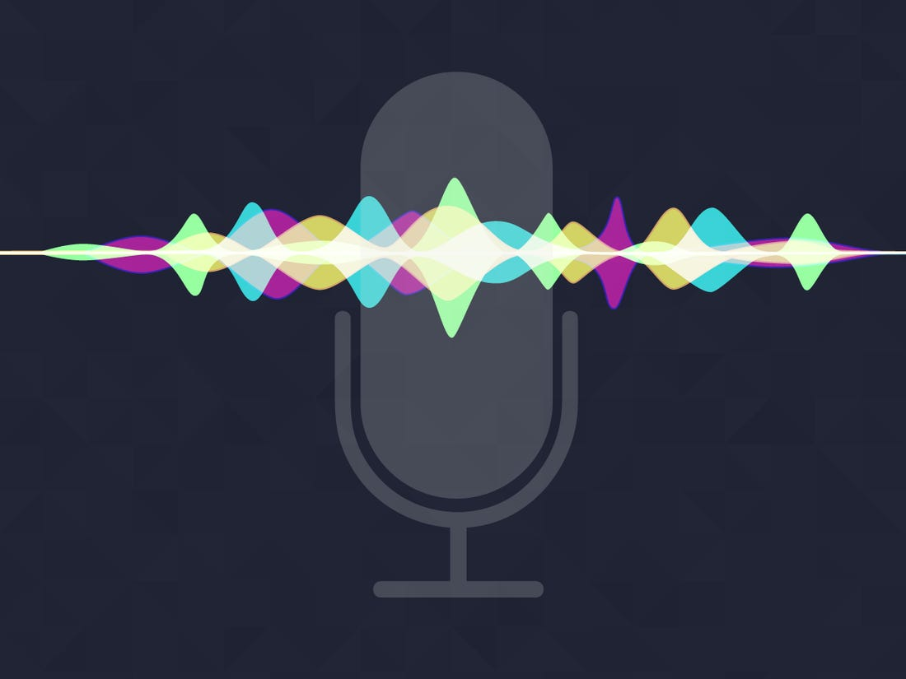
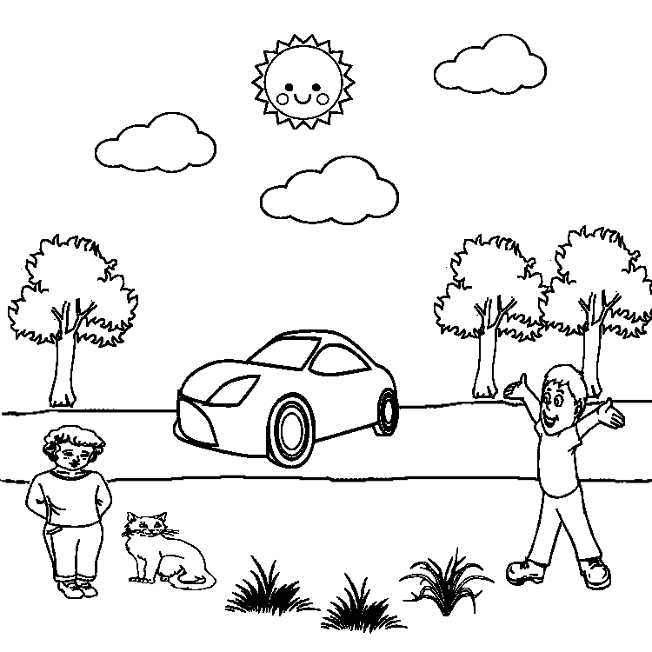


Motivation: Scene Sketch Understanding
Natural language
Scene sketch colorization
5
6
Notes:
To evaluate a model’s ability of understanding a scene-level sketch, the direct way is to change or edit this sketch. [#click]
[#click]
So, based on this, we proposed to construct a simple application: scene sketch colorization, with human language as the editing instruction to the model.

Slide 7
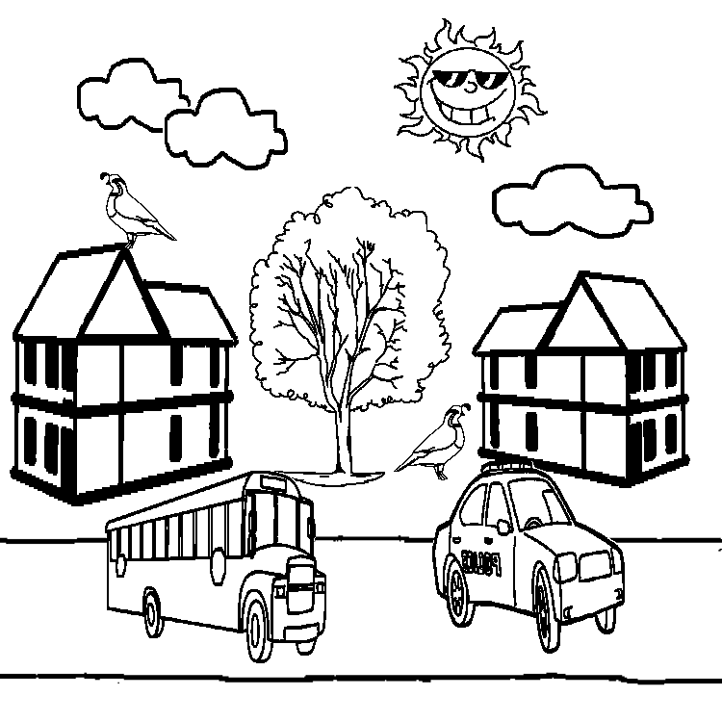
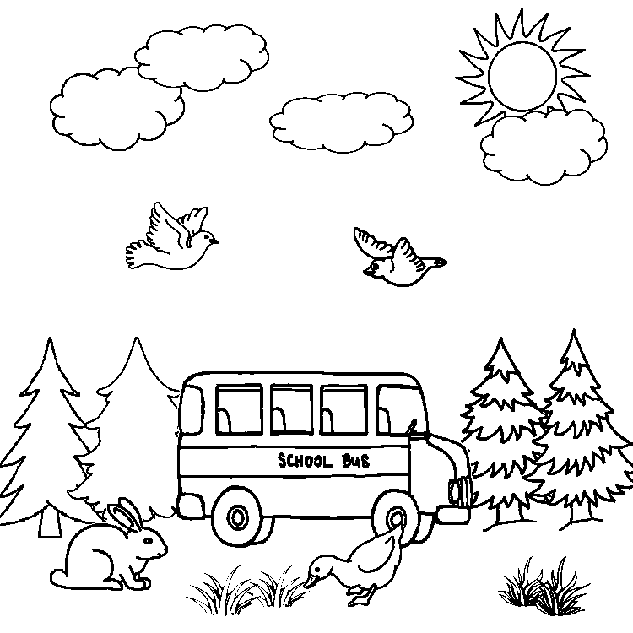
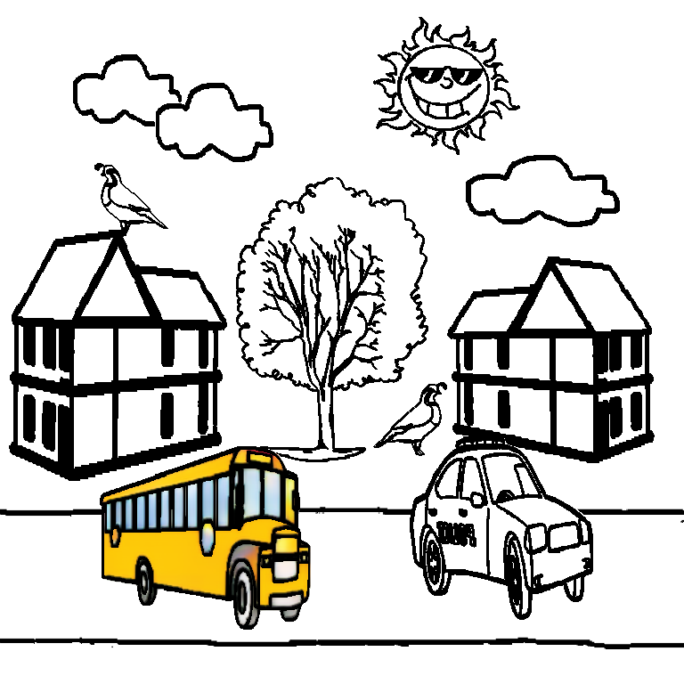
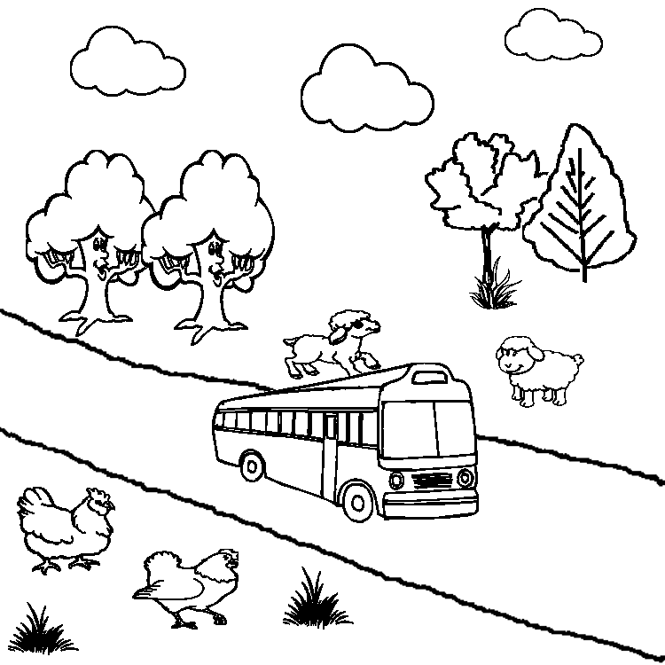
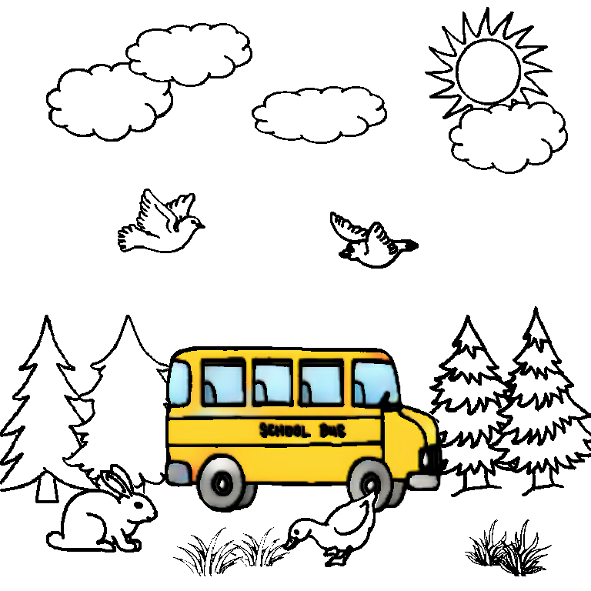
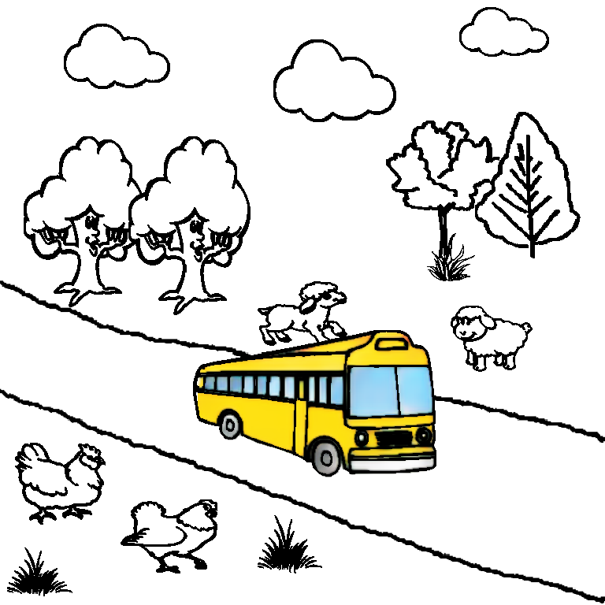
Motivation: Why Language-based?
Natural: easily adopted by novice users
Touchless: friendly for people with upper limb impairments
Effective: support batch-processing colorization
“the bus is yellow with blue windows”
7
Notes:
But, why do we use language-base input?
[#click]
First, we think language-based interface is so natural that is can be easily adopted by novice users.
[#click]
Then, it is touchless, so it is friendly for people with upper limb impairments.
[#click]
Lastly, it is so effective that it can support batch-processing colorization. [#click] For example, “the bus…”, [#click] it is done simultaneously.

Slide 8
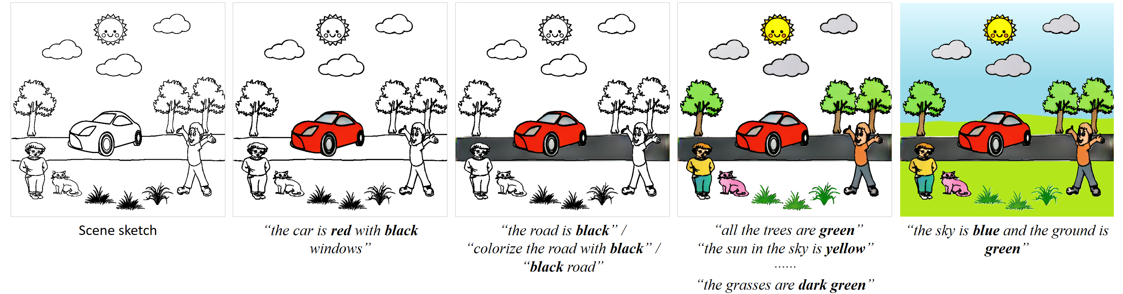
Motivation: Language-based Sketch Colorization
Toy problem, but not simple ……
8
Notes:
It seems it is a toy problem, but actually we found it is not simple at all, and there exist several challenges.

Slide 9
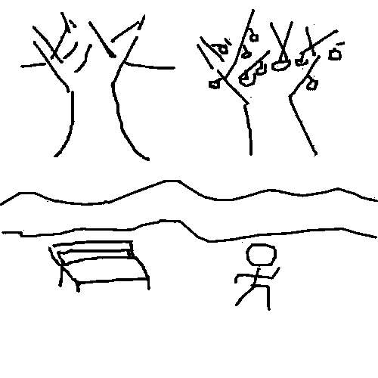
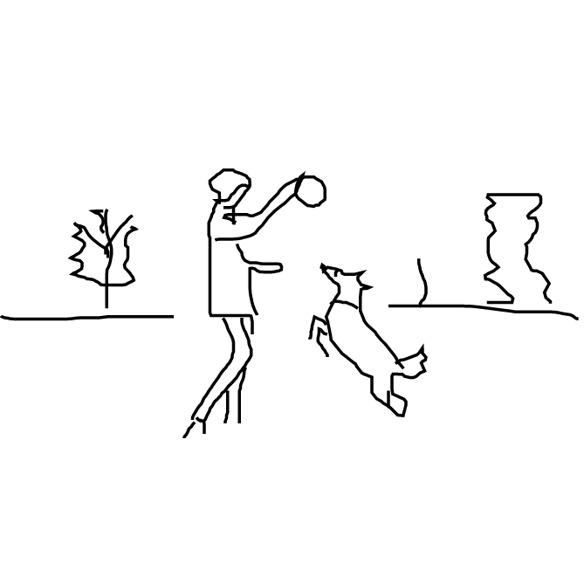
Challenges
A. Understanding scene-level sketch is very hard
Too abstract
Lack of contextual information
CMPlaces
[Castrejon et. al 2016]
Photo-Sketching
[Li et. al 2019]
SketchyScene
[Zou et. al 2018]
9
Notes:
The first challenge is the understanding of scene-level sketches.
As mentioned before, the sketch data is too abstract, moreover, it lacks contextual information.

Slide 10
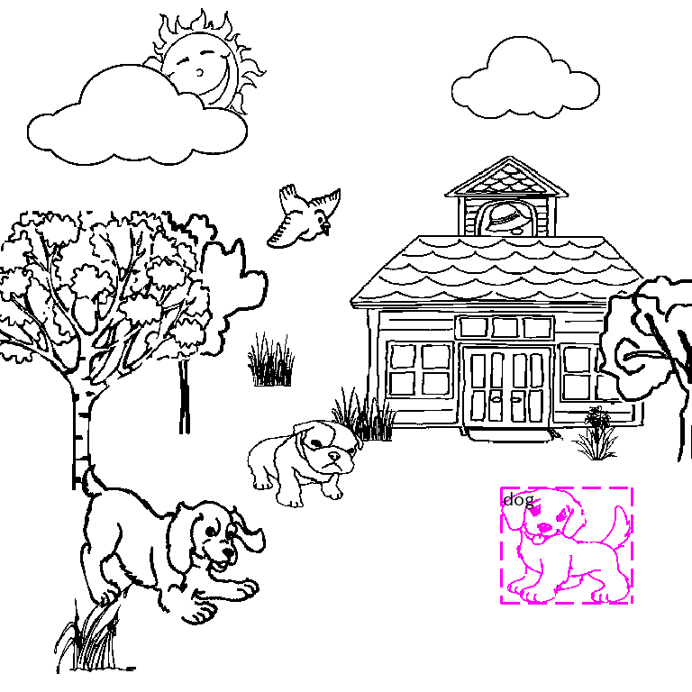
Challenges
B. Multimodal learning between language and scene sketch
Mapping between language and target objects
“the dog on the rightmost has orange body”
10
Notes:
The second challenge lies in the [multimodal learning between language and scene sketch. ...
...

Slide 11
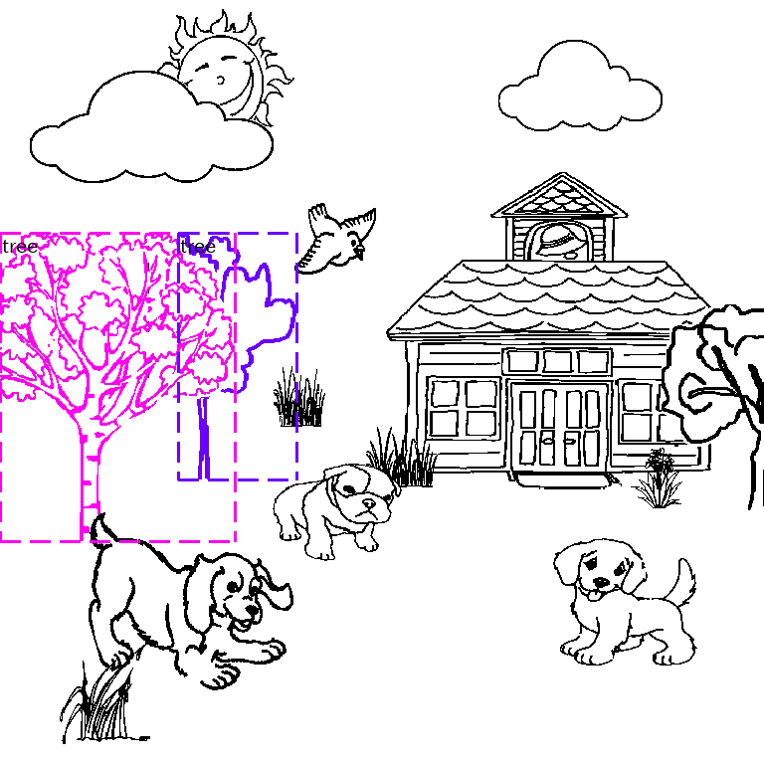
Challenges
B. Multimodal learning between language and scene sketch
Mapping between language and target objects
One or multiple objects with single instruction
“the two trees on the left of the house are light green”
10
Notes:
...

Slide 12
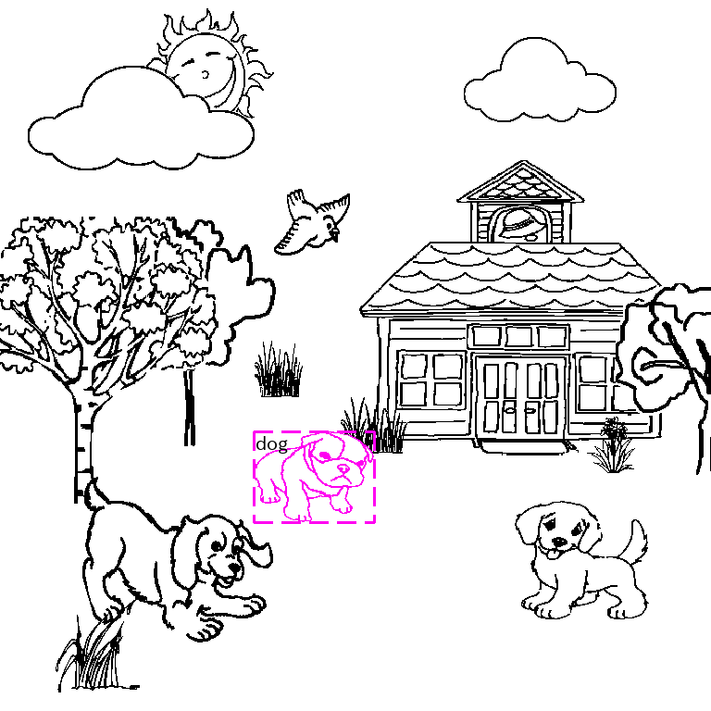
Challenges
B. Multimodal learning between language and scene sketch
Mapping between language and target objects
One or multiple objects with single instruction
Various free expressions of location
“the dog in the middle is gray ”
/
“the dog near the house is gray”
10
Notes:
...

Slide 13

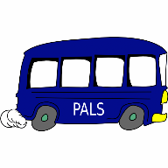
Challenges
C. Multimodal learning between language and object sketch
Object-part-level colorization
Various free expressions of colors
“the bus is dark (navy/…) blue with white windows”
11
Notes:
Another challenge is about the [multimodal learning between language and object-level sketch.
…,
…

Slide 14

Inspiration: Drawing and Intelligence Development
Sensitive to line drawing and color
Mode of thinking and creation
12
Notes:
With our toy application, we hope it can inspire some further research which can contribute to the field of education and cognition development.
Many psychology researches have found the importance of drawing and coloring to the kid’s intelligence development, because children are sensitive to them.

Slide 15
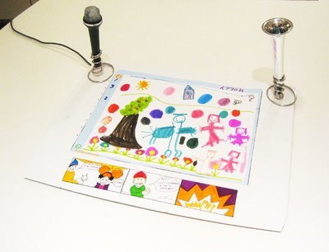
Inspiration: Language and Literacy Development
Embedding voice in traditional drawings supports children’s literacy development
[Raffle et. al 2007]
13
Notes:
Moreover, embedding voice in the traditional drawing is interesting, and a research has found this approach can support children’s literacy development.

Slide 16
Related Work
Notes:
Next, I would like to introduce some related researches to our work.

Slide 17
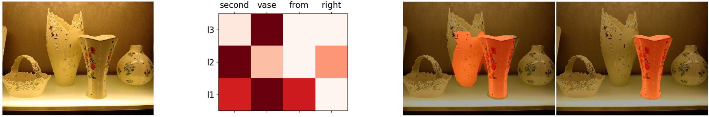
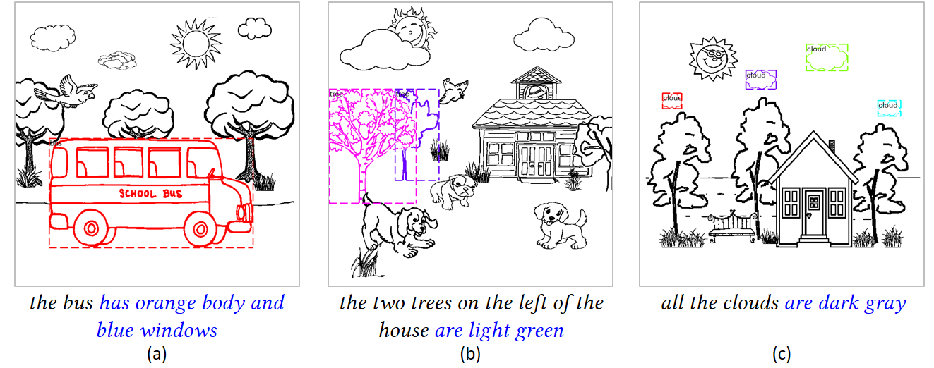
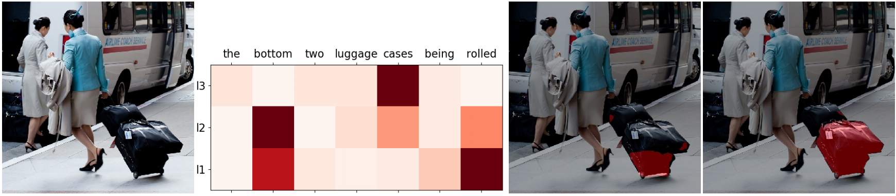
Related Work
A. Language-based Image Segmentation
Fusion of textual and visual information
Only natural images
Only one binary mask for single or multiple target objects
“second vase from right”
“the bottom two luggage cases being rolled”
[Ye et. al 2019]
Our work
14
Notes:
For language-based image segmentation. There exist several works, [#click] but nearly all of them focus on natural images instead of scene sketches.
And they generate only one binary mask for single or even multiple target objects. But in our task, we need individual instance-level binary mask for each of the target objects.

Slide 18
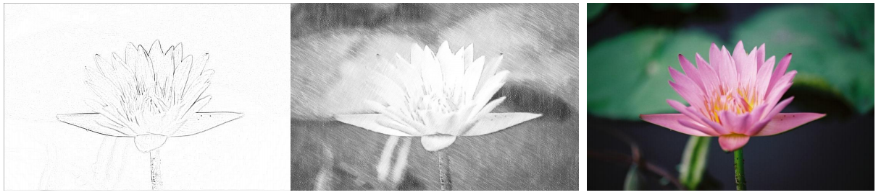
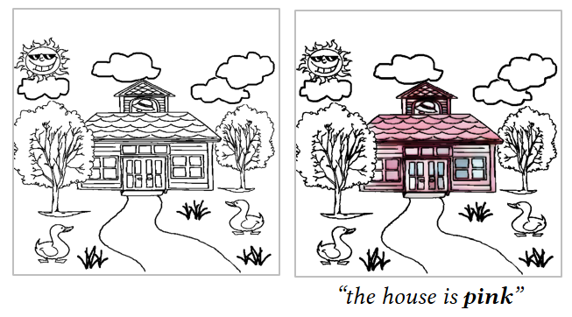
Related Work
B. Language-based Image Colorization
Language-based image editing (LBIE) [Chen et. al 2018]
Require pair-wise scene-level sketch and color image
“The flower has red petals with yellow stigmas in the middle”
Scene sketch
[Chen et. al 2018]
Our work
[1] Jianbo Chen, et. al. Language-Based Image Editing With Recurrent Attentive Models. In CVPR, 2018.
15
Notes:
For language-based image colorization, the existing works [#click] require pair-wise data for training.
Obviously it is hard to collect pair-wise scene-level data in our task.

Slide 19
Our Work
Notes:
let’s see how our work goes.

Slide 20
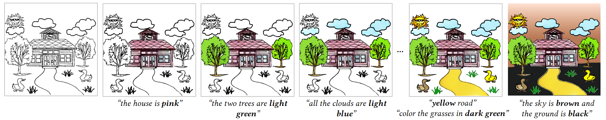
Main contributions
Language-based colorization system for scene sketches
Language-based instance segmentation network for scene sketches
Three large-scale datasets for language-based scene sketch colorization
16
Notes:
The main contributions of our work are
we have designed the first language-based scene sketch colorization system. In this system, we designed the first network for language-based instance segmentation of scene sketches. We also collected three large-scale datasets for this task.

Slide 21
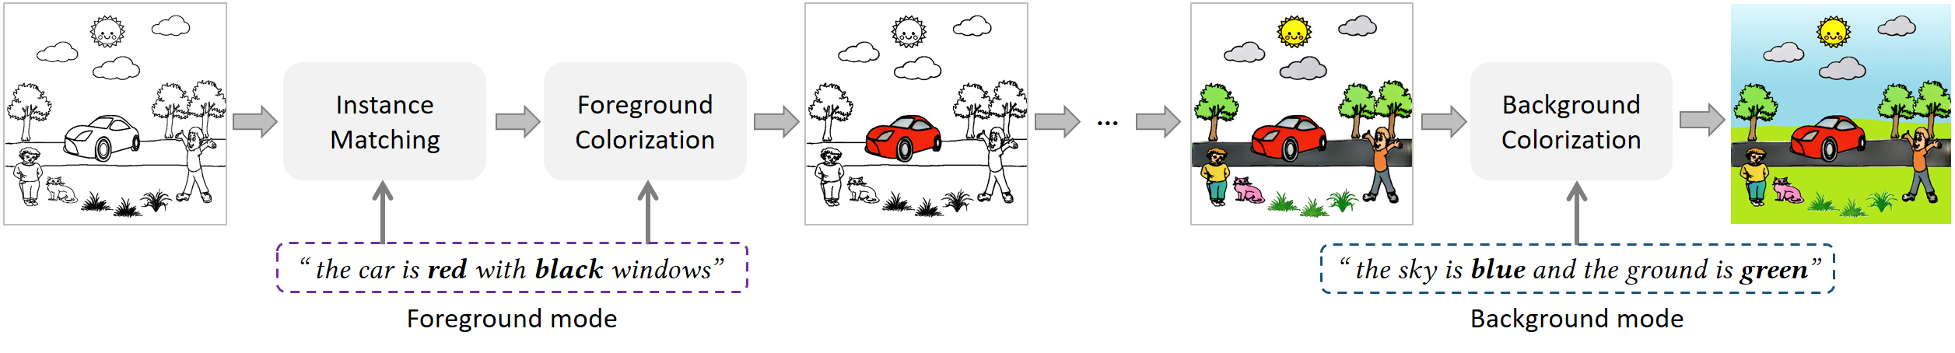
Proposed approach
A. System pipeline
Divide-and-conquer and progressive strategy
Two modes (foreground and background)
Three models (instance matching, foreground colorization, background colorization)
System pipeline
17
Notes:
First, let me introduce the pipeline of our system. As it is not easy to collect pair-wise scene-level data, so we decompose a scene sketch into foreground objects and background regions.
Therefore, this problem can be solvable by training on pair-wise object-level sketch and color images. So our system is designed with a divide-and-conquer strategy, and offers two modes for [#click] foreground and background colorization.
In the foreground mode, our system first uses an instance matching model [#click] to locate the foreground target objects.
And then a foreground colorization model [#click] is used to colorize the located targets.
In the background mode, our system uses a background colorization model [#click] to colorize the background.

Slide 22
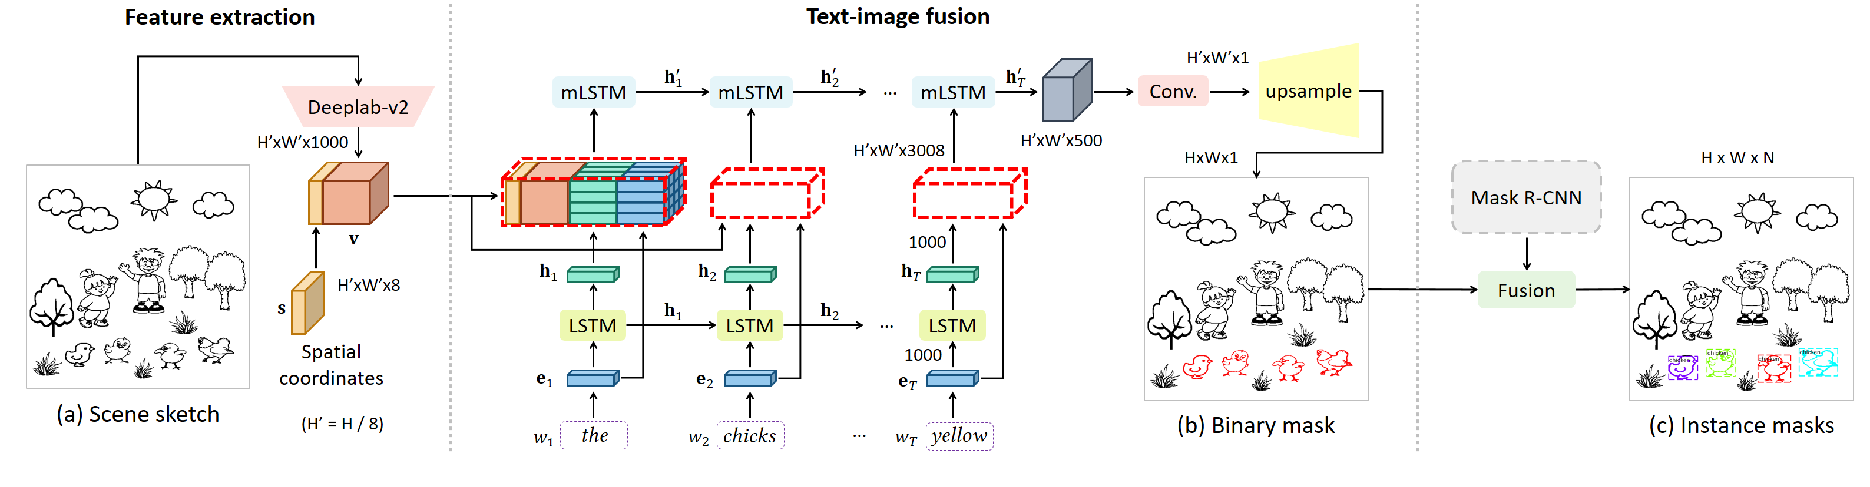
Proposed approach
B.1 Instance Matching Model
Training: two phases for binary mask (b) generation
Inferring: fuse binary mask with instance segmentation results
Foreground mode
18
Notes:
Next, let’s go into the three models.
In the instance matching model, during training, the input scene sketch will go through[#click] a feature extraction phase and [#click] a text-image fusion phase, and the model will generate a binary mask for [#click] all the target objects,
Then, in inferring stage, [#click] this model will fuse this binary mask with the instance segmentation results, and obtain the final instance segmentation mask for each target objects.

Slide 23
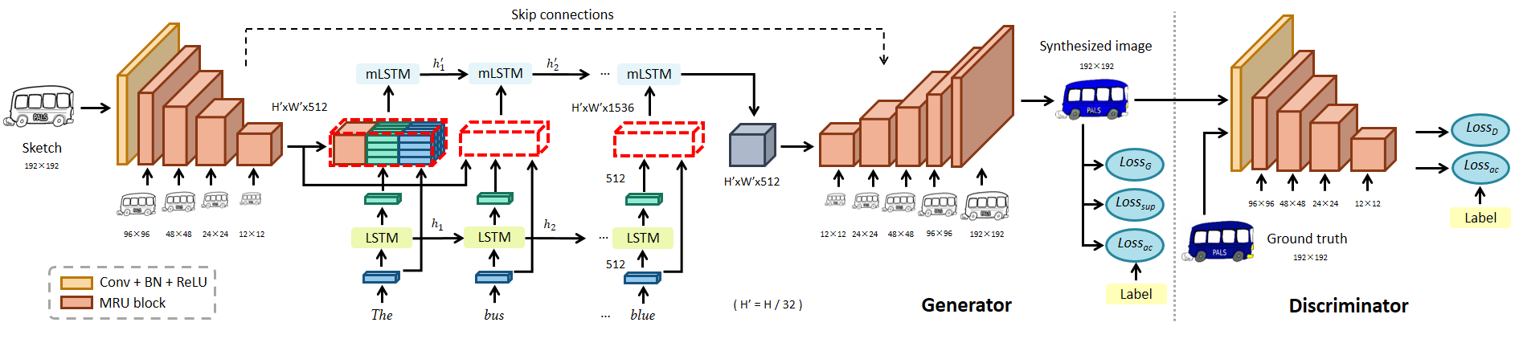
Proposed approach
B.2 Foreground Colorization Model
GAN + fusion module
Colorize objects from different categories
Foreground mode
20
Notes:
Then, in the foreground colorization model, we designed a GAN-based network integrated with a fusion module. The fusion module [#click] is injected between encoder and decoder in the Generator. It fuses the text information into the image feature maps. [#click] Our foreground colorization model is able to colorize object sketches of different categories.

Slide 24
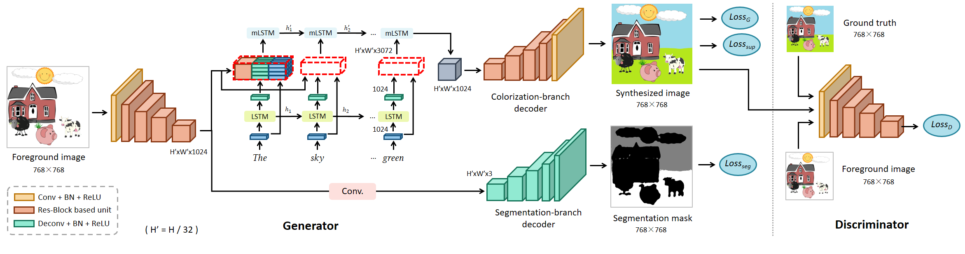
Proposed approach
B.3 Background Colorization Model
cGAN + two-branch decoder
Colorization branch
Explicit segmentation branch (segmentation loss)
Background mode
21
Notes:
Lastly, in the background colorization model, we designed a conditional GAN integrated with a fusion module and a two-branch decoder. The fusion module [#click] is placed in the colorization branch. We added into an explicit segmentation branch [#click] to improve the model’s segmentation ability.
An additional segmentation loss is added because of this extra branch.

Slide 25
Datasets
MATCHING dataset: 38k groups of text-based instance segmentation data.
22
Notes:
With the above three deep networks, we collected three large-scale datasets for their training and testing.
The data for text-based instance segmentation of scene sketch, .

Slide 26
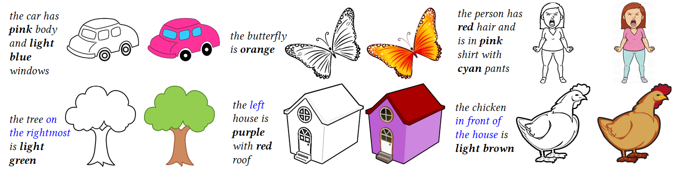
Datasets
MATCHING dataset: 38k groups of text-based instance segmentation data.
FOREGROUND dataset: 4k groups of text-based sketch object colorization data.
22
Notes:
, for text-based sketch object colorization

Slide 27
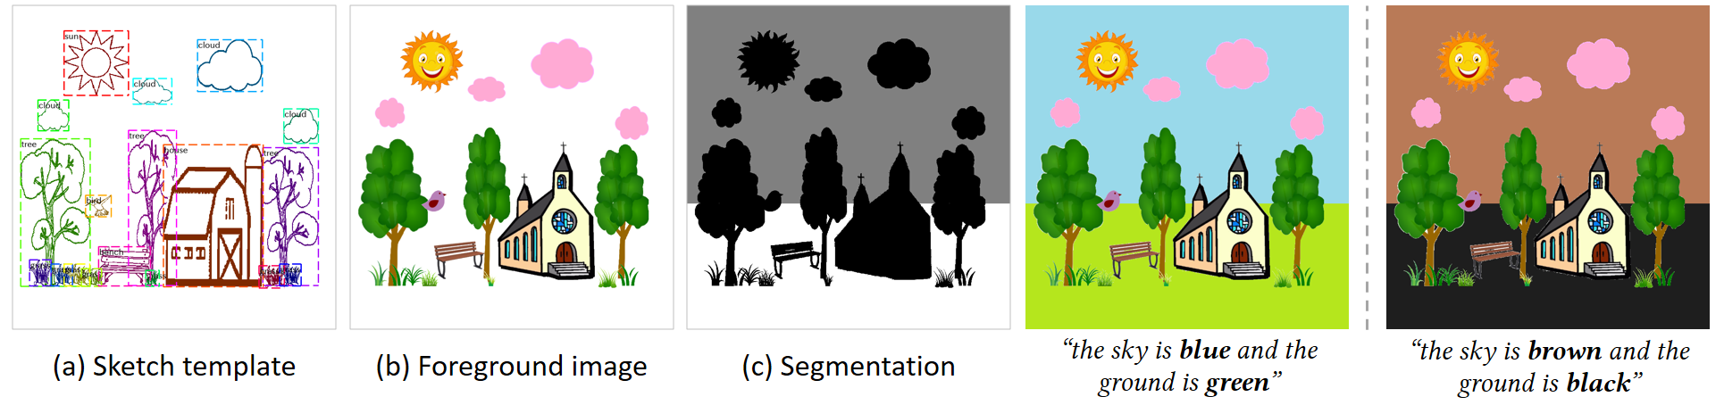
Datasets
MATCHING dataset: 38k groups of text-based instance segmentation data.
FOREGROUND dataset: 4k groups of text-based sketch object colorization data.
BACKGROUND dataset: 20k groups of text-based background colorization data.
22
Notes:
and for text-based background colorization.

Slide 28
Results: Un-targeted
A. Un-targeted colorization experiment
Colorize a sketch with free instructions
Single object
“the bus is yellow with blue windows”
23
Notes:
Next, let’s see the final results of our system. To evaluate the performance of our system, we have conducted several experiments.
The first one is un-targeted colorization experiment. We invited some users to give free instructions as they like to colorize the scene sketches.
Here is an example.
First, the instruction is “the bus…”, and the system outputs the result like this.

Slide 29
Results: Un-targeted
A. Un-targeted colorization experiment
Colorize a sketch with free instructions
Single object
“the bus is yellow with blue windows”
23

Slide 30
Results: Un-targeted
A. Un-targeted colorization experiment
Colorize a sketch with free instructions
Multiple objects
“all the trees are dark green”
23
Notes:
Then, another instruction describes multiple objects, “all the trees ”. And the result like this.

Slide 31

Results: Un-targeted
A. Un-targeted colorization experiment
Colorize a sketch with free instructions
Multiple objects
“all the trees are dark green”
23

Slide 32
Results: Un-targeted
A. Un-targeted colorization experiment
Colorize a sketch with free instructions
Colorize the background before all foregrounds
“the sky is blue and the ground is green”
23
Notes:
our system supports colorizing the background before all the foreground objects having been colorized

Slide 33
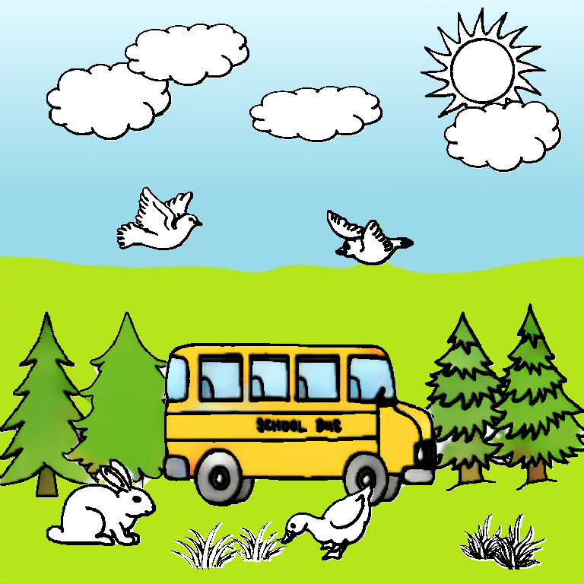
Results: Un-targeted
A. Un-targeted colorization experiment
Colorize a sketch with free instructions
Colorize the background before all foregrounds
“the sky is blue and the ground is green”
23

Slide 34
Results: Un-targeted
A. Un-targeted colorization experiment
Colorize a sketch with free instructions
Language grammar error
“the clouds are are in dark gray”
23
Notes:
our system can also handle the instruction with language grammar error, like “the clouds are are …”.

Slide 35
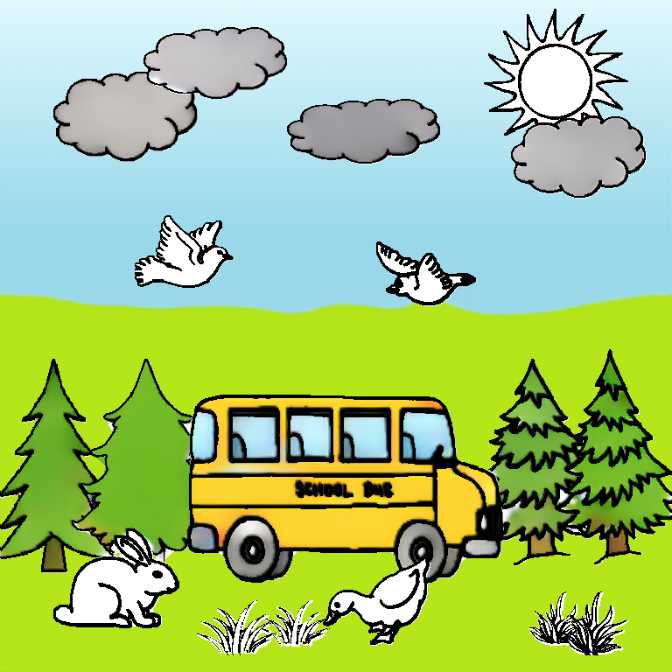
Results: Un-targeted
A. Un-targeted colorization experiment
Colorize a sketch with free instructions
Language grammar error
“the clouds are are in dark gray”
23

Slide 36
Results: Un-targeted
A. Un-targeted colorization experiment
Colorize a sketch with free instructions
“the sun is yellow”
“the bird on the left is red”
“the bird on the right is dark brown”
23
Notes:
Then, some normal cases.

Slide 37
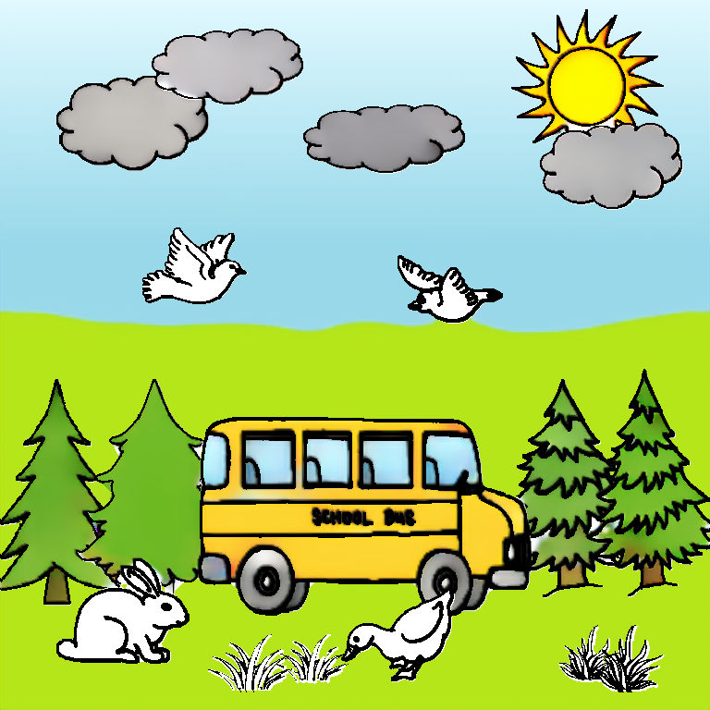
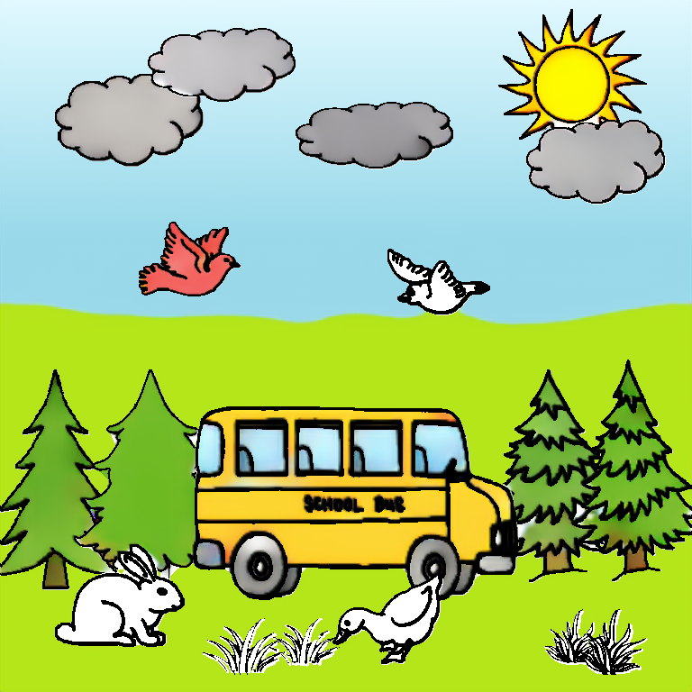
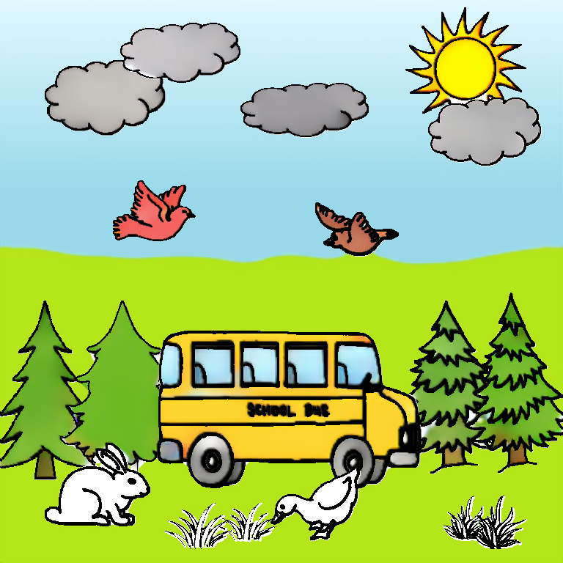
Results: Un-targeted
A. Un-targeted colorization experiment
Colorize a sketch with free instructions
“the sun is yellow”
“the bird on the left is red”
“the bird on the right is dark brown”
23

Slide 38
Results: Un-targeted
A. Un-targeted colorization experiment
Colorize a sketch with free instructions
Unsupported words
“let the rabbit be in pink”
23
Notes:
Sometimes, the instructions might contain unsupported words, which never exist in the training data. Our system can also handle this.

Slide 39
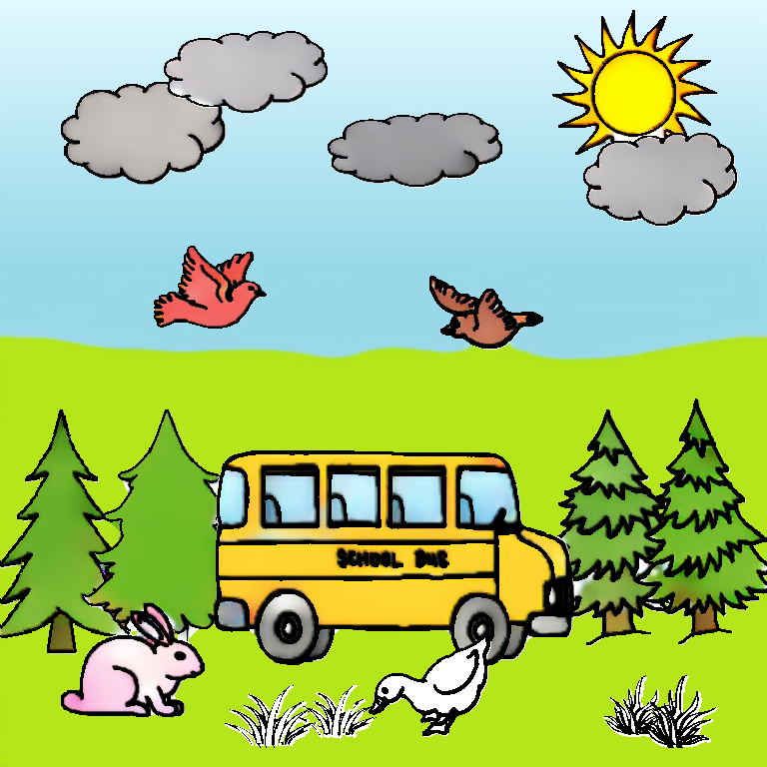
Results: Un-targeted
A. Un-targeted colorization experiment
Colorize a sketch with free instructions
Unsupported words
“let the rabbit be in pink”
23

Slide 40
Results: Un-targeted
A. Un-targeted colorization experiment
Colorize a sketch with free instructions
“the duck on the right is orange”
“dark green grasses”
23
Notes:
Then, also some normal cases.

Slide 41
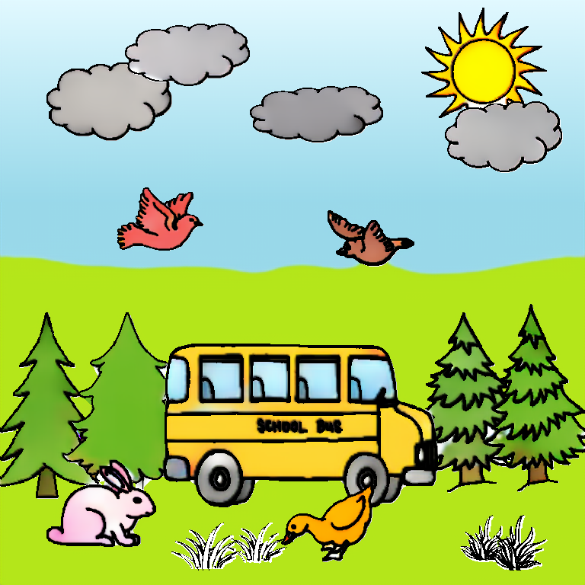
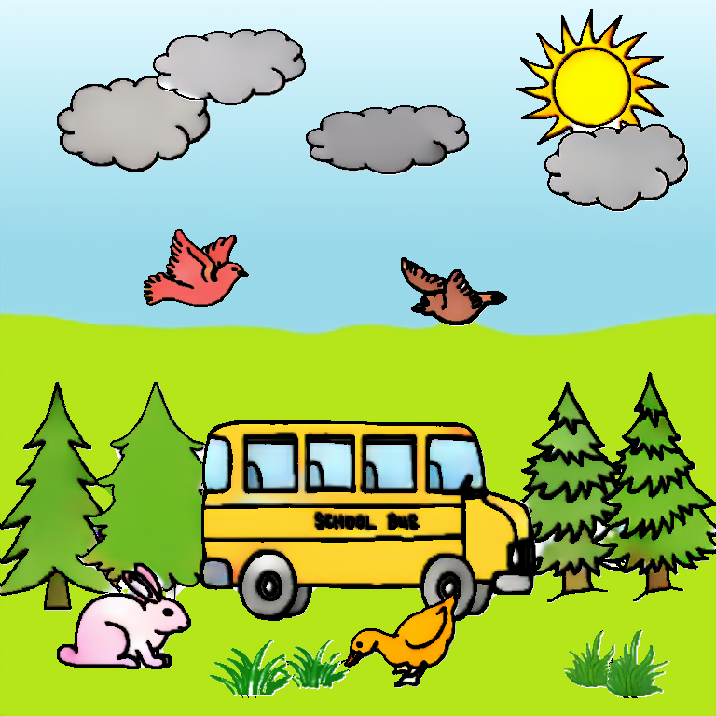
Results: Un-targeted
A. Un-targeted colorization experiment
Colorize a sketch with free instructions
“the duck on the right is orange”
“dark green grasses”
23

Slide 42
Results: Un-targeted
A. Un-targeted colorization experiment
Colorize a sketch with free instructions
Re-colorization
“colorize the bus in purple”
23
Notes:
Finally, our system also supports re-colorization.

Slide 43
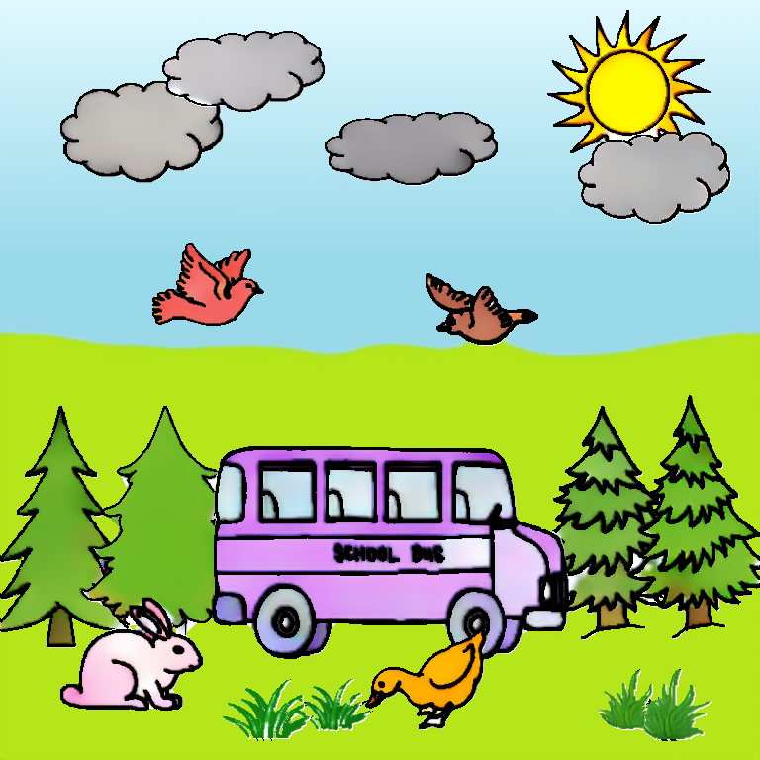
Results: Un-targeted
A. Un-targeted colorization experiment
Colorize a sketch with free instructions
Re-colorization
“colorize the bus in purple”
23

Slide 44
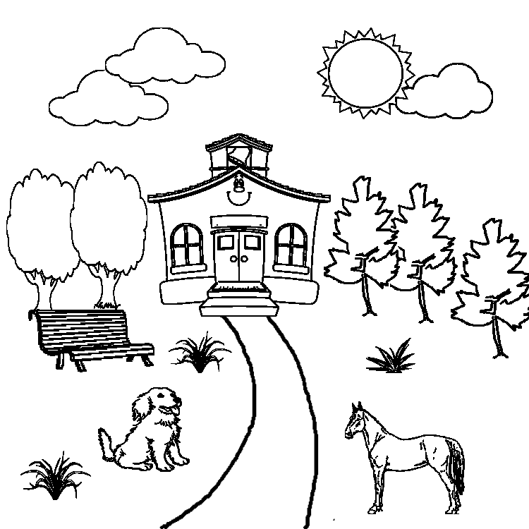





Results: Un-targeted
A. Un-targeted colorization experiment
“the house is orange with dark brown roof”
“the three trees on the right are dark green”
“the two trees on the left are dark green”
“the sky is cyan and the ground is gray”
“let the dog to be gray”
…
24
Notes:
Here are more results of this experiment.

Slide 45






Results: Un-targeted
A. Un-targeted colorization experiment
“the person on the left has red hair and is in dark brown shirt with light blue pants”
“the person on the right has red hair and is in orange shirt with yellow pants”
“colorize the sky purple and ground yellow”
“clouds are blue in the sky”
“grasses are green”
“the two ducks are yellow”
“the pig on the left is pink”
25

Slide 46




Results: Targeted
B. Targeted colorization experiment
Colorize a sketch into target color images
“The sun is yellow”
“All the chickens are yellow”
“The house is red with dark brown roof and light blue windows”
“The sun is yellow with orange flame”
“All chickens are yellow with red crest and yellow feet”
“The walls of the house are brown and the roof of the house is red”
Target
User A
User B
26
Notes:
We conducted another experiment called targeted colorization experiment.
We invited several pairs of users to [#click] colorize the sketch into a target color image as closely as possible.
What we want to see is our system should produce similar results even with different language expressions from different users, [#click] and this reflects the ability of our system to handle expression diversity.
In this example, we can see, though the expressions are quite different, our system still produces similar results.

Slide 47




Results: Targeted
B. Targeted colorization experiment
Colorize a sketch into target color images
“the house is yellow with red roof”
“one duck on the left is purple”
“the other duck on the right is white”
“the house with red roofs has yellow doors”
“the left duck is purple”
“the right duck is white”
Target
User A
User B
27
Notes:
Here are more results

Slide 48




Results: Targeted
B. Targeted colorization experiment
Colorize a sketch into target color images
“the leftmost bird is dark blue”
“the bird on the right most is dark blue”
“the two middle birds have blue body”
“the birds are all blue”
Target
User A
User B
28

Slide 49



Results: Generalization
C.1 Generalization experiment: cartoon-style drawings
“the person in the middle has dark brown hair and is in pink shirt with light gray pants”
“the person on the right has light brown hair and is in orange shirt with black pants”
29
Notes:
We also conducted experiments to evaluate the generalization ability of our system. We applied our system to wild sketches, like cartoon-style drawings,

Slide 50



Results: Generalization
C.1 Generalization experiment: cartoon-style drawings
“the rabbit on the right is light brown”
“the rabbit on the upper left is dark gray”
30

Slide 51




Results: Generalization
C.2 Generalization experiment: anime line art
“the person on the left has light brown hair and is in red shirt with dark gray pants”
“the person on the right has red hair and is in orange shirt with cyan skirt”
“the sky is pink and the ground is yellow”
31
Notes:
anime line art,

Slide 52




Results: Generalization
C.3 Generalization experiment: artist freehand drawing
“the person on the left has red hair and is in yellow shirt with cyan pants”
“the person on the right has red hair and is in light brown shirt with purple pants”
“the sky is blue and the ground is green”
32
Notes:
artist freehand drawing,

Slide 53






Results: Generalization
C.4 Generalization experiment: non-artist freehand sketches
“the dog is dark brown”
“the car is yellow with blue window”
Sketchy
[Sangkloy et al. 2016]
“the house is blue with gray roof”
33
Notes:
and non-artist freehand sketches.
These are object-level freehand sketches.

Slide 54





Results: Generalization
C.4 Generalization experiment: non-artist freehand sketches
“all the trees are dark green”
“the dog on the right is dark brown”
“the sky is blue and the ground is green”
“the person is in light brown shirt with red pants”
Photo-Sketching
[Li et al. 2019]
34
Notes:
And these is a scene-level freehand sketch.

Slide 55


Limitations: Language Generality for Matching
“the bus is blue and the tree is light green”
“the tree is light green and the bus is blue”
Multiple objects of different categories
35
Notes:
However, as we are taking the first step towards this challenging problem, so there still exist several limitations of our system.
The first one is the language generality for instance matching.
Generally, human will describe multiple objects of different categories in a single instruction. But it is difficult for our system to fully understand these complex expressions. And it cannot locate all the target objects.

Slide 56

Limitations: Language Generality for Matching
“the taxi is yellow with blue windows”
“the little boy has …”
“the little girl is in …”
Alternative category names not in training data
36
Notes:
In another case, when the sentence contains alternative category names, which are not in the training data, the model can not understand it at all and segment nothing.

Slide 57

Limitations: Language Generality for Colorization
Arbitrary part-level information
Arbitrary colors
“the wheels of the car is…”
“… blonde hair”
37
Notes:
Apart from the language generality for matching, there is also a limitation for colorization.
For example, some users gave instructions with arbitrary part-level information, like “the wheels …”, or with arbitrary colors, like “blonde hair”. These descriptions never exist in the training data, so it is difficult for the model to understand.

Slide 58



Limitations: Colorization Artifacts
Incorrect segmentation
Uncolored pixels
38
Notes:
Another main limitation lies in the colorization artifacts.
We can see here that, the model made incorrect segmentation so the colorization results are not reasonable.
At the region between the little boy’s legs, there exists uncolored pixels.

Slide 59

Limitations: Colorization Artifacts
Aliasing artifact
39
Notes:
From the region here, we can see aliasing artifact.

Slide 60







Future work: Multimodal Colorization System
Language-based: more natural and accessible
Scribble-based: direct and precise control
40
Notes:
one of the future direction of our work can be to construct a [multimodal colorization system. We think both language-based and the traditional scribble-based interfaces have their own advantages.
So we envision a practical [multimodal colorization system including both types of interfaces.

Slide 61
To conclude
Human’s understanding of abstract data at scene level.
The first language-based colorization system for scene sketches.
Three large-scale datasets for language-based scene sketch colorization.
Plausible results with room for improvement.
Notes:
At last, let me have a conclusion of my presentation.
We intend to explore human’s understanding of abstract data at scene level.
To achieve this goal, we came up with an application called language-based scene sketch colorization, and have taken the first step towards this challenging problem.
We designed a system and collected three large-scale datasets for this task and obtained plausible results.
But there still exist several limitations and much room for improvement.

Slide 62
Dataset and code
Project Page: https://sketchyscene.github.io/SketchySceneColorization/
Code: https://github.com/SketchyScene/SketchySceneColorization
Lab. Homepage: http://sysu-imsl.com/
Acknowledgments
Participants on data annotations
Reviewers
Guangzhou Science Technology and Innovation Commission
City University of Hong Kong
Thank you!
Notes:
We have released all the datasets and source code in github. So If you are interested, please see it for more details.
Thank you!

